Slide 1
Project Presentation of FSE
On
UPlacement- JOB SEARCHING PORTAL
Khushi, 2210991795
Kashish Sharma, 2210991770
Kartikay Singh Manhas, 2210991761
Supervised By
Rahul Sir
Department of Computer Science and Engineering,
Chitkara University, Punjab

Slide 2
Introduction
The Uplacement Job Portal is a web application developed using the MERN stack. This platform is designed to facilitate the connection between job seekers and employers by providing a centralized and efficient space for job applications and recruitment processes.
Job seekers can register, create profiles, upload resumes, search for jobs, and apply directly through the portal also.
They can see the learning content for the particular job category directly from the portal. Employers can sign up to post job openings, view applications, and manage candidates.
The backend, built with Node.js and Express.js, ensures robust server-side operations and smooth API integration.
MongoDB securely stores user data, job listings, and application details.
The frontend, developed with React.js, delivers a responsive and intuitive user interface, enhancing the overall user experience.
Feature of admin dashboard where the admin can gain insights about the number of users registered on the platform and also take necessary actions on them , if required.
2

Slide 3
Problem Statement
The traditional recruitment process faces several challenges, making job searching and hiring inefficient and frustrating for both job seekers and employers. Manual screening of applications slows down hiring, leading to delays and increased workload for recruiters. Bias in hiring decisions results in missed talent opportunities, affecting diversity and fairness in recruitment. Poor job matching prevents candidates from finding the right opportunities, while fragmented tools make the hiring process complex and disorganized.
These challenges highlight the need for a streamlined, efficient, and unbiased recruitment solution. UPlacement addresses these issues by integrating AI-driven job matching, automated screening, and a user-friendly platform to ensure a faster, smarter, and fairer hiring experience.

Slide 4
Software & Hardware Requirements
1.Operating System :Windows
2.Database: MongoDB
3.Programming languages : React, Node.js, Express.js
4.Development Tools : VSCode , Git, Github
5. Hardware: Intel Core i5 or AMD Ryzen 5,2,4 GHz or higher
Minimum 8 GB RAM,SSD with atleast 256 GB

Slide 5
USE CASES
1.User Registration and Login
Description: Allows users (job seekers and employers) to create an account and log in to access the portal's features.
2. Job Posting
Description: Enables employers to post job vacancies on the platform with detailed descriptions, requirements, and other relevant information.
3. Job Search
Description: Allows job seekers to search for job opportunities using a search bar.

Slide 6
USE CASES
4.Job Application
Description: Allows job seekers to apply for jobs directly through the platform by submitting their profiles and resumes.
5. Learning Content:
Description: Allows job seekers to see the learning material for the particular job category.
6. Application Management
Description: Allows employers to view and manage the applications they receive, including shortlisting, rejecting, or contacting candidates.

Slide 7
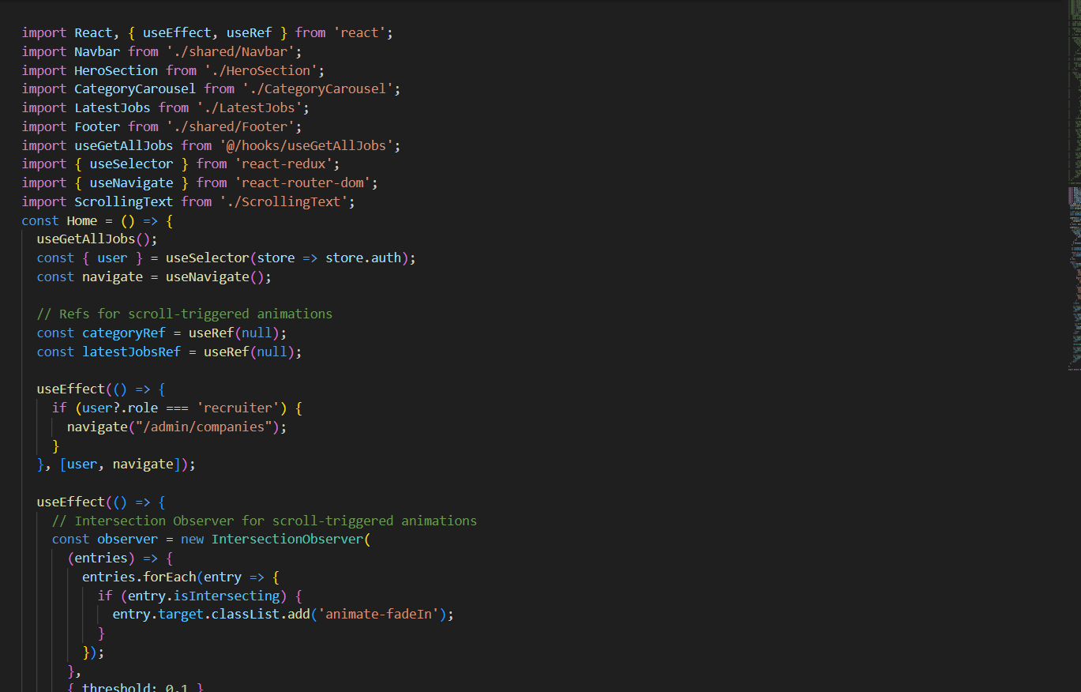
Code Snapshots

Slide 8
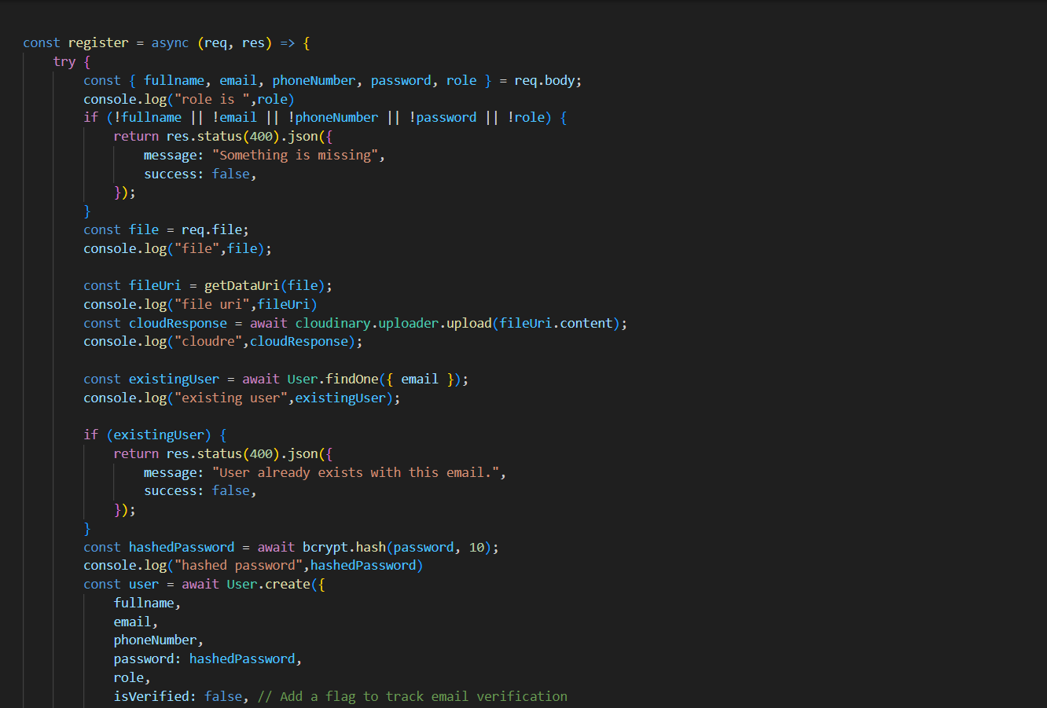
Code Snapshots

Slide 9
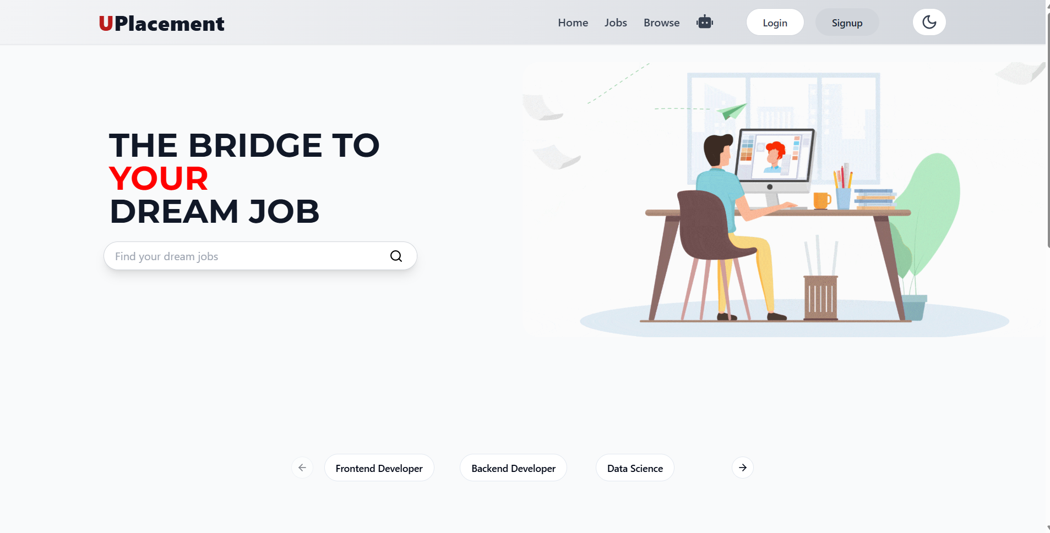
Project Snapshots

Slide 10
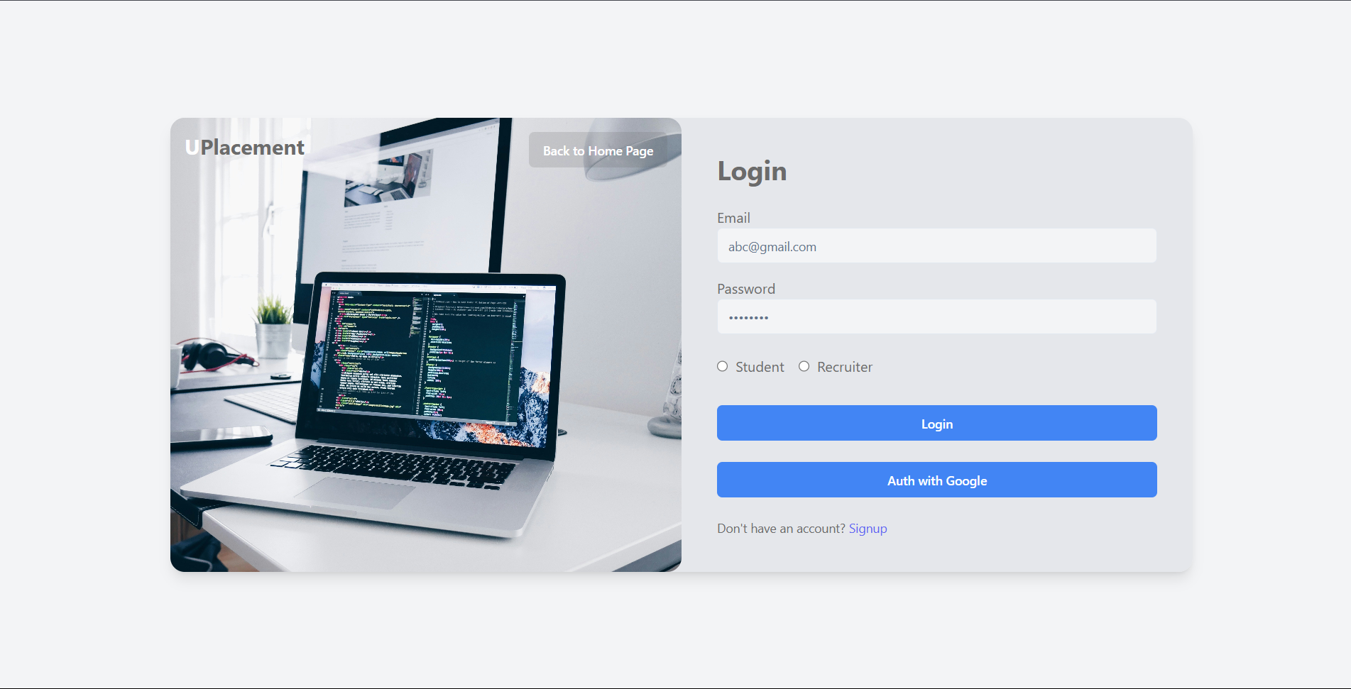

Slide 11
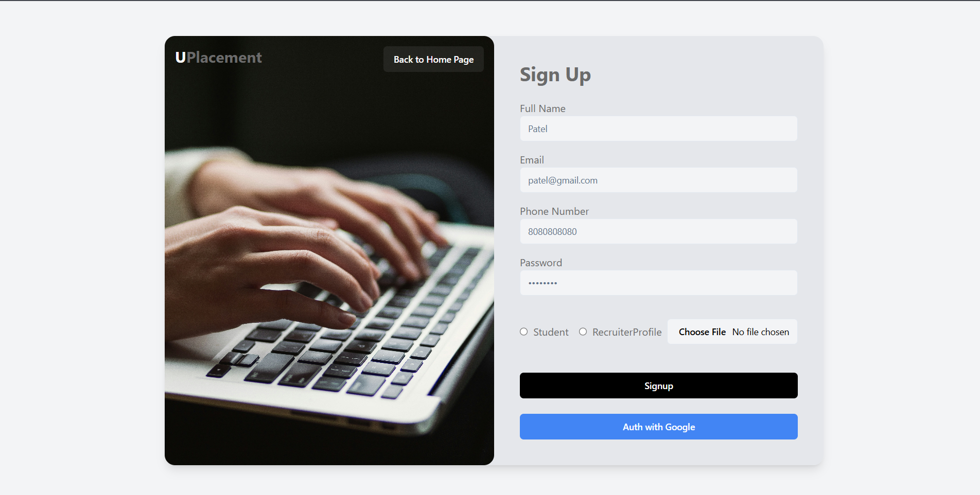

Slide 12
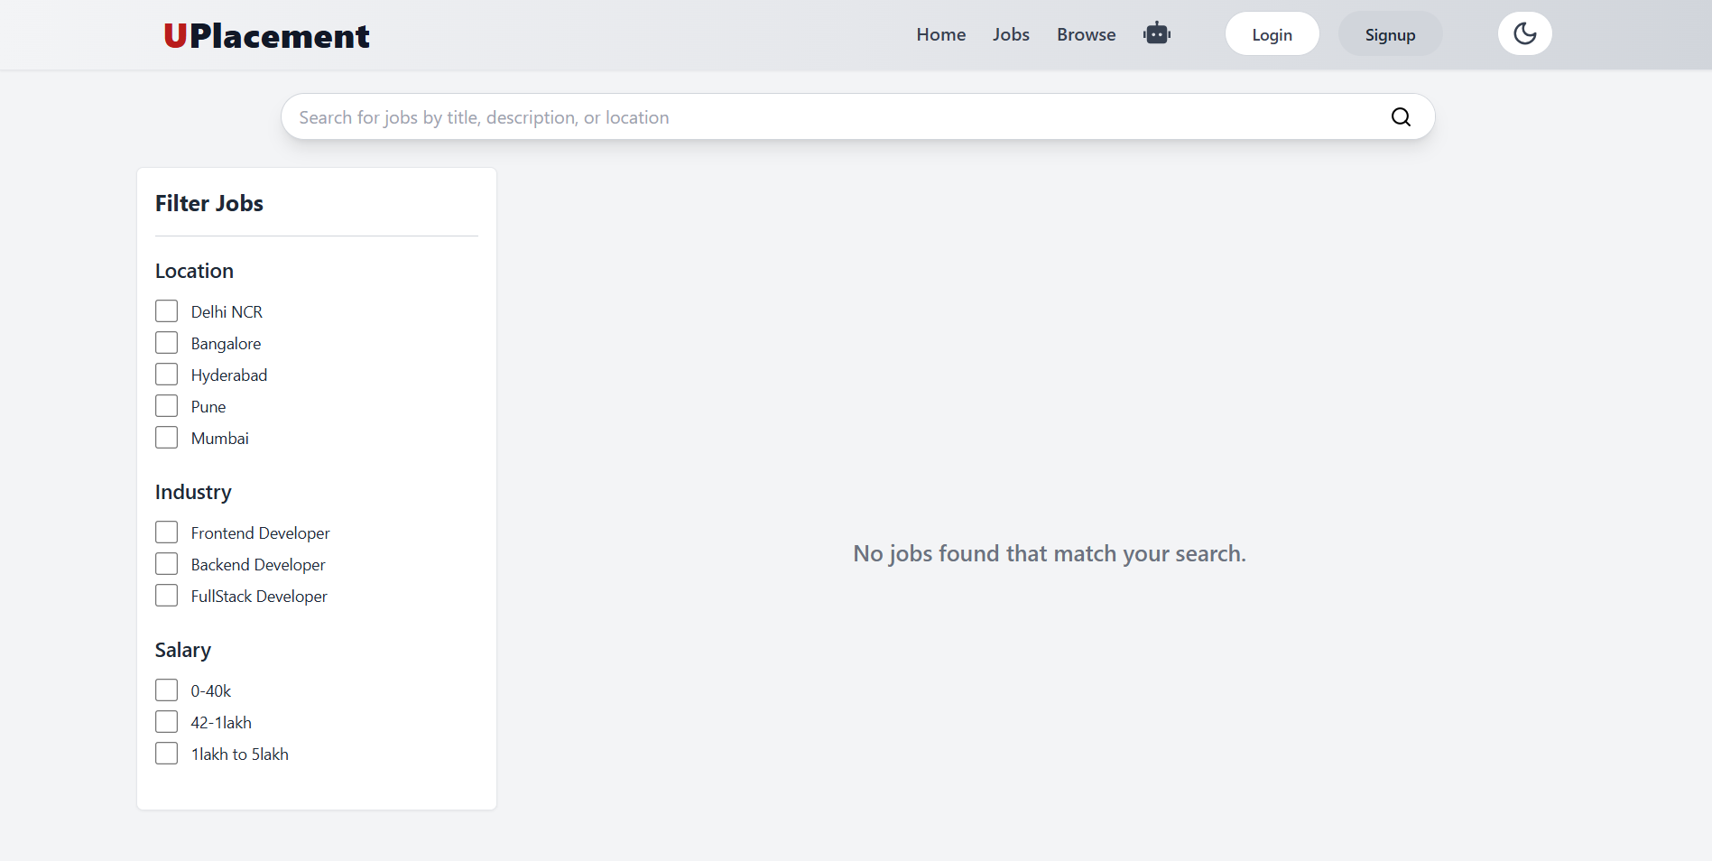

Slide 13
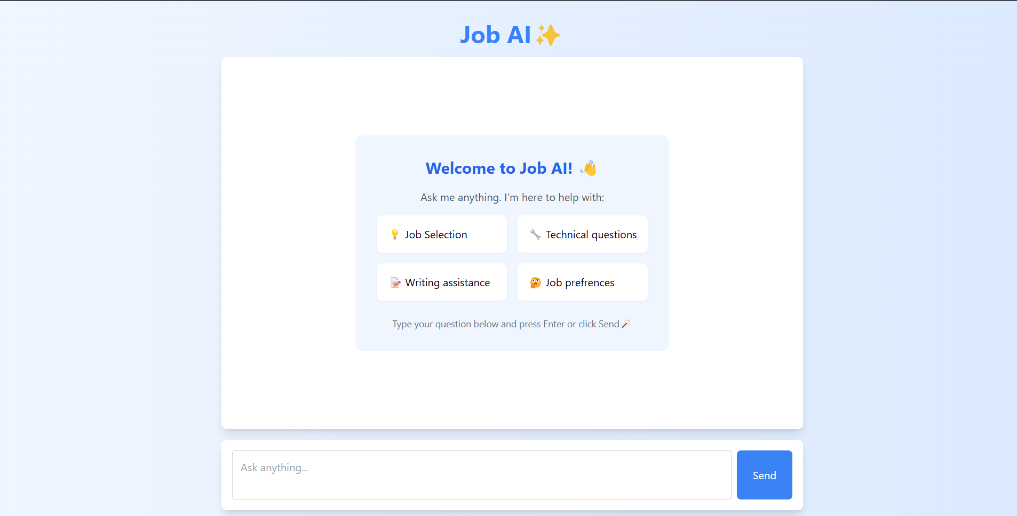

Slide 14
Conclusion
In conclusion, the Uplacement job searching portal developed using the MERN stack successfully delivers a scalable and efficient solution for job searching and recruitment. The integration of MongoDB, Express.js, React.js, and Node.js ensures high performance and a smooth user experience.
This project highlights the effectiveness of the MERN stack in creating modern web applications and sets the stage for future enhancements, such as advanced search features and real-time notifications, to further improve functionality and user engagement.

Slide 15
Future Scope
Advanced Search and Filtering: Enhance the search functionality with more refined filters and algorithms to improve the precision of job and candidate searches.
Real-time Features: Implement real-time notifications and updates for job applications and messages to keep users engaged and informed.
AI and Machine Learning Integration: Utilize AI and machine learning for personalized job recommendations, resume matching, and automated candidate screening.
Analytics and Reporting: Create dashboards and reporting tools for employers and administrators to track job post performance, user activity, and application metrics.
ChatBot: Create a realtime ChatBot where job seekers can chat directly with the employer or company officials.
Skill Assessment Test: Add quiz options for the job seekers to test their skiils .

Slide 16
Thank You
16

